Slide 1
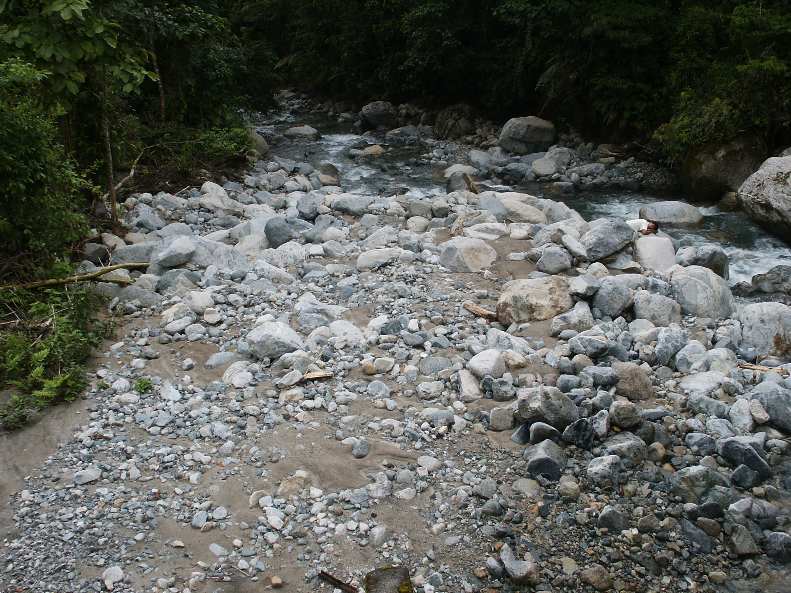


Grain Size Distribution
Allen Bateman Pinzón ---- Curso …… 2014/2015

Slide 2
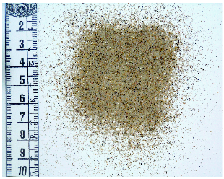
Grain Size Distribution slides from Gary PArker
CHARACTERIZATION OF SEDIMENT AND GRAIN SIZE DISTRIBUTIONS
For sufficiently coarse particles, the “diameter” D is often defined to be the dimension of the smallest square mesh opening through which the particle will pass. For finer particles, “diameter” D often denotes the diameter of the equivalent sphere with the same fall velocity v_{s} [L/T] as the actual particle.
Grain size is often specified in terms of a
base-2 logarithmic scale (phi scale or psi scale).
These are defined as follows: where D is given in mm
Allen Bateman Pinzón ---- Curso …… 2014/2015

Slide 3
Título/Capítulo
Grain Size Distribution
SAMPLE EVALUATIONS OF ψ AND φ
D (mm) | ψ | φ
4 | 2 | -2
2 | 1 | -1
1 | 0 | 0
0.5 | -1 | 1
0.25 | -2 | 2
0.125 | -3 | 3
Allen Bateman Pinzón ---- Curso …… 2014/2015

Slide 4
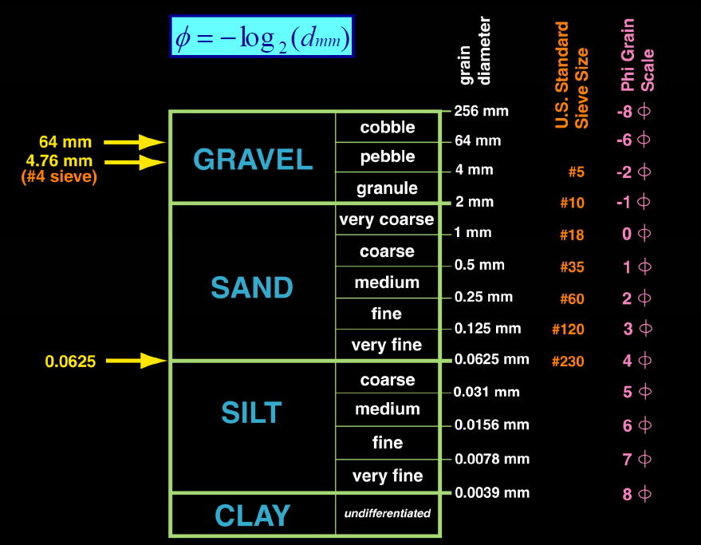
Grain Size Distribution
SEDIMENT SIZE RANGES
Mineral clays such as smectite, montmorillonite and bentonite are cohesive, i.e. characterized by electrochemical forces that cause particles to stick together. Even silt-sized particles that are do not consist of mineral clay often display some cohesivity due to the formation of a biofilm.
Allen Bateman Pinzón ---- Curso …… 2014/2015

Slide 5
Título/Capítulo
Grain Size Distribution
SEDIMENT GRAIN SIZE DISTRIBUTIONS
The grain size distribution is characterized in terms of N+1 sizes D_{b,i} such that f_{f,i} denotes the mass fraction in the sample that is finer than size D_{b,i}.
i | D_{b,i} mm | f_{f,i}
1 | 0.03125 | 0.020
2 | 0.0625 | 0.032
3 | 0.125 | 0.100
4 | 0.25 | 0.420
5 | 0.5 | 0.834
6 | 1 | 0.970
7 | 2 | 0.990
8 | 4 | 1.000
Note the use of a logarithmic scale for grain size.
Allen Bateman Pinzón ---- Curso …… 2014/2015

Slide 6
Título/Capítulo
Grain Size Distribution
SEDIMENT GRAIN SIZE DISTRIBUTIONS contd.
In the last slide, the finest size (0.03125 mm) was such that 2 percent was finer. If the finest size does not correspond to 0 percent content, or the coarsest size to 100 percent content, it is often useful to use linear extrapolation on the psi scale to determine the missing values.
Extrapolation
Log (D)
Allen Bateman Pinzón ---- Curso …… 2014/2015

Slide 7
Título/Capítulo
Grain Size Distribution
SEDIMENT GRAIN SIZE DISTRIBUTIONS contd.
i | D_{b,i} mm | f_{f,i}
1 | 0.0098 | 0
2 | 0.03125 | 0.020
3 | 0.0625 | 0.032
4 | 0.125 | 0.100
5 | 0.25 | 0.420
6 | 0.5 | 0.834
7 | 1 | 0.970
8 | 2 | 0.990
9 | 4 | 1.000
i | D_{b,i} mm | f_{f,i}
1 | 0.03125 | 0.020
2 | 0.0625 | 0.032
3 | 0.125 | 0.100
4 | 0.25 | 0.420
5 | 0.5 | 0.834
6 | 1 | 0.970
7 | 2 | 0.990
8 | 4 | 1.000
Note that the addition of the extra point has increased N from 8 to 9 (there are N+1 points).
Allen Bateman Pinzón ---- Curso …… 2014/2015

Slide 8
Título/Capítulo
Grain Size Distribution
SEDIMENT GRAIN SIZE DISTRIBUTIONS contd.
The grain size distribution after extrapolation is shown below.
i | D_{b,i} mm | f_{f,i}
1 | 0.0098 | 0
2 | 0.03125 | 0.020
3 | 0.0625 | 0.032
4 | 0.125 | 0.100
5 | 0.25 | 0.420
6 | 0.5 | 0.834
7 | 1 | 0.970
8 | 2 | 0.990
9 | 4 | 1.000
Allen Bateman Pinzón ---- Curso …… 2014/2015

Slide 9
Título/Capítulo
Grain Size Distribution
CHARACTERISTIC SIZES BASED ON PERCENT FINER
D_{x} is size such that x percent of the sample is finer than D_{x}
Examples:
D₅₀ = median size
D₉₀ ~ roughness height
Allen Bateman Pinzón ---- Curso …… 2014/2015

Slide 10
Título/Capítulo
Grain Size Distribution
CHARACTERISTIC SIZES BASED ON PERCENT FINER
To find D_{x} (e.g. D₅₀) find i such that
Then interpolate for ψ_{x}
and back-calculate D_{x} in mm
Allen Bateman Pinzón ---- Curso …… 2014/2015

Slide 11
Título/Capítulo
Grain Size Distribution
STATISTICAL CHARACTERISTICS OF SIZE DISTRIBUTION
ψ_{i} (D_{i}) = characteristic size of ith grain size range
f_{i} = fraction of sample in ith grain size range
Allen Bateman Pinzón ---- Curso …… 2014/2015

Slide 12
Título/Capítulo
Grain Size Distribution
STATISTICAL CHARACTERISTICS OF SIZE DISTRIBUTION contd.
= mean grain size on psi scale
σ = standard deviation on psi scale
D_{g} = geometric mean size
σ_{g} = geometric standard deviation ( ≥ 1)
Sediment is well sorted if σ_{g} < 1.6
D_{g} = 0.273 mm, σ_{g} = 2.17
Allen Bateman Pinzón ---- Curso …… 2014/2015

Slide 13
Título/Capítulo
Grain Size Distribution
Example: WHY CHARACTERIZE GRAIN SIZE DISTRIBUTIONS IN TERMS OF
A LOGARITHMIC GRAIN SIZE?
Consider a sediment sample that is half sand, half gravel (here loosely interpreted as material coarser than 2 mm), ranging uniformly from 0.0625 mm to 64 mm. Plotted with a logarithmic grain size scale, the sample is correctly seen to be half sand, half gravel. Plotted using a linear grain size scale, all the information about the sand half of the sample is squeezed into a tiny zone on the left-hand side of the diagram.
Logarithmic scale for grain size
Linear scale for grain size
Allen Bateman Pinzón ---- Curso …… 2014/2015

Slide 14
Título/Capítulo
Grain Size Distribution
UNIMODAL AND BIMODAL GRAIN SIZE DISTRIBUTIONS
The fractions f_{i}(ψ_{i}) represent a discretized version of the continuous function f(ψ), f denoting the mass fraction of a sample that is finer than size ψ. The probability density p_{f} of size ψ is thus given as p = df/dψ.
The example to the right corresponds to a Gaussian (normal) distribution with:
= -1 (D_{g} = 0.5 mm) and
σ = 0.8 (σ_{g} = 1.74)
Allen Bateman Pinzón ---- Curso …… 2014/2015

Slide 15
Título/Capítulo
Grain Size Distribution
UNIMODAL AND BIMODAL GRAIN SIZE DISTRIBUTIONS
The probability density p_{f} of size ψ is given as p = df/dψ.
The grain size distribution is called unimodel because the function p(ψ) has a single mode, or peak.
The following approximations
are valid for a Gaussian distribution:
Allen Bateman Pinzón ---- Curso …… 2014/2015

Slide 16
Título/Capítulo
Grain Size Distribution
UNIMODAL AND BIMODAL GRAIN SIZE DISTRIBUTIONS contd.
A sand-bed river has a characteristic size of bed surface sediment (D₅₀ or D_{g}) that is in the sand range.
The grain size distributions of most sand-bed streams are unimodal, and can often be approximated with a Gaussian function.
Many gravel-bed river, however, show bimodal grain size distributions, as shown to the upper right. Such streams show a sand mode and a gravel mode, often with a paucity of sediment in the pea-gravel size (2 ~ 8 mm).
A bimodal (multimodal) distribution can be recognized in a plot of f versus ψ in terms of a plateau (multiple plateaus) where f does not increase strongly with ψ.
Allen Bateman Pinzón ---- Curso …… 2014/2015

Slide 17
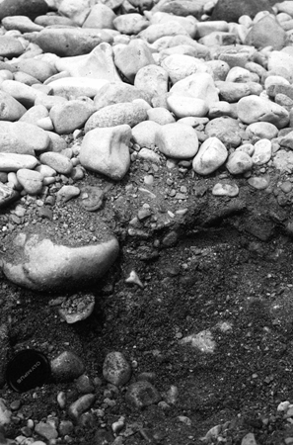
Título/Capítulo
Allen Bateman Pinzón ---- Curso …… 2014/2015

